Slide 1
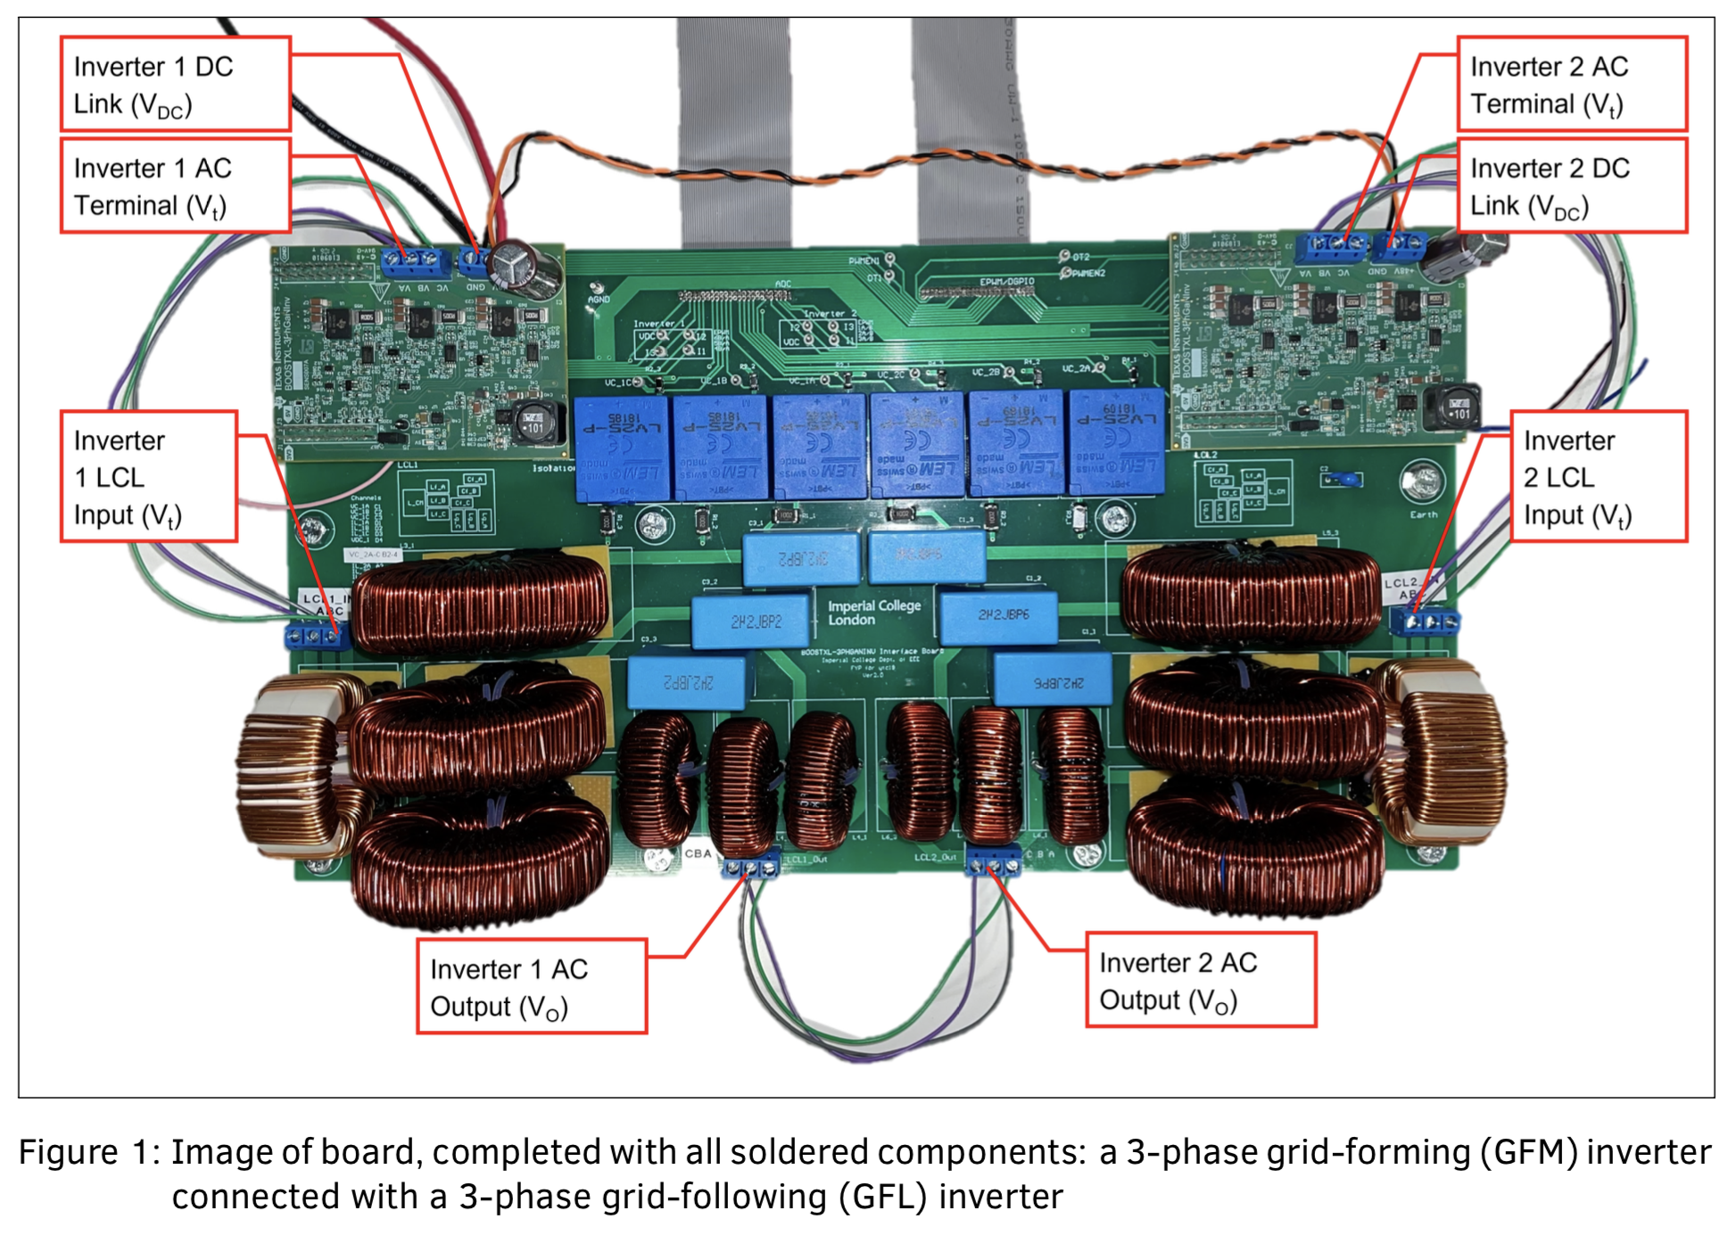
Deployment of Rapid Control Prototyping Technique for 3-phase Inverters
Wednesday, 28 June 2023
Final Year Project Presentation
Yan To Chau (01705211)
1
Notes:
Deployment of RCP (rapid control prototyping for 3-phase inverter)
Before we go any further: quick look at the final hardware produced for the project, which is shown in a system level diagram later
Overview: Intro, 3 main concepts, tests and demo

Slide 2
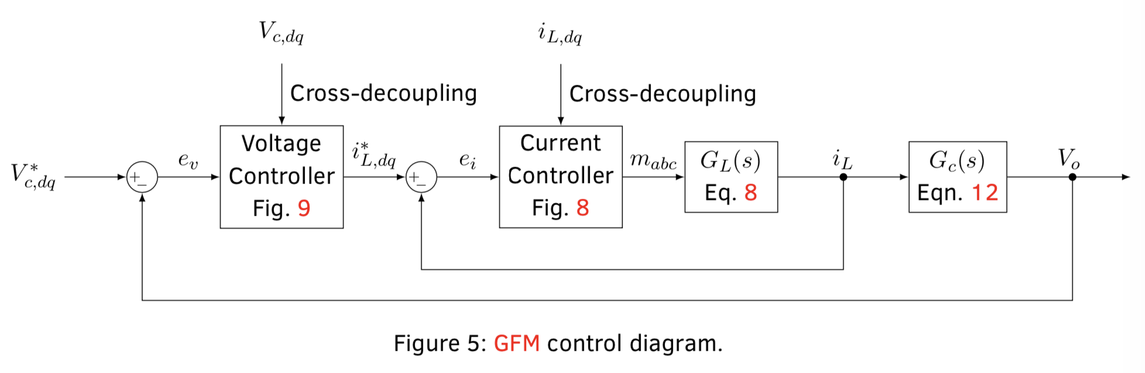
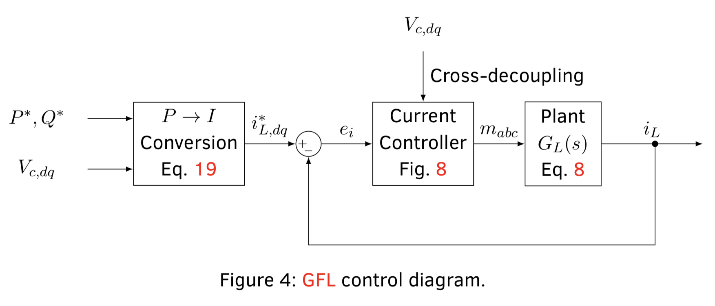
GFM (Forming) vs GFL (Following) Inverters
Introduction
1/1
GFM: Tracks a grid voltage and frequency reference regardless of DC voltage or load variations
UPS (uninterruptible supply): supplying to loads of an isolated network
GFL: Tracks a current reference, control power exchange
Example: Connections of PV farm or ESS to an AC grid
Switch between modes.
2
Notes:
An IBR connected to an AC grid (with little synchronous generation) can switch between GFM and GFL mode.
GFM: start from black out to initialise a stiff grid voltage
GFL: then when the grid is stable or when the system inertia is built it can run in GFL to maximise power.
As shown in the diagram
GFL: current control
GFM: outer loop voltage control and inner loop current control
Current control offers control over power, and also limits the current at switches
Switch between GFM and GFL modes: for example, startup of an AC grid from black-out, using an IBR (inverter-based resource)

Slide 3
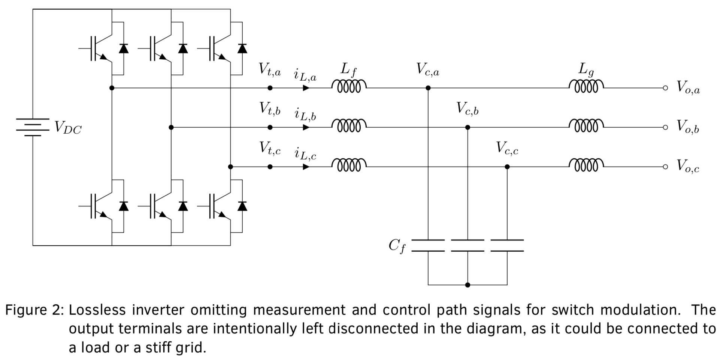
Inverter Hardware
Hardware
1/1
3 Phase DC-AC half bridge
LCL Filter
CMC (Common Mode Choke)
3
Notes:
NO MORE THAN 10 SECONDS
3 parts of an inverter that I will not go in detail today
Inverter: Formed by 3 single-phase DC-AC half bridge.
LCL filter: Comparison between this and L and LC filter: Further ripple current attenuation by grid side inductor, capacitor that absorbs high frequency currents (reactive power)
CMC: Cancels out CM voltage which is the difference in voltage between the DC ground and capacitor neutral.

Slide 4
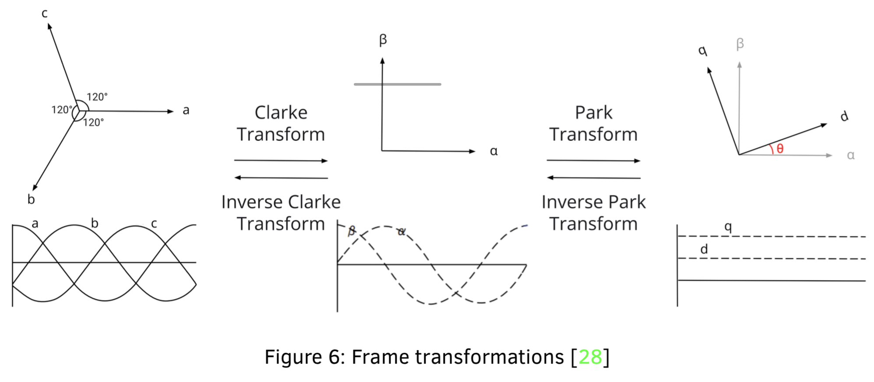
Reference Frames
Dynamics
1/2
abc (stationary): 3 balanced quantities in a stationary co-planar frame
αβ (natural): 2 orthogonal quantities in a stationary orthogonal frame
dq (synchronous): 2 DC orthogonal quantities in a rotating orthogonal frame
4
Notes:
(Before I talk about Plant Equations)
Reference frames is important
Stationary frame to control (hard to control sinusoidally varying waveform)
Draw attention to dq -> 2 DC orthogonal quantities in a rotating orthogonal frame
Because tracking signal is DC, reference can be DC too, making it much easier to control.
Hard to control 3 coupled signals
PLL ensures it rotates at the correct speed and phase

Slide 5
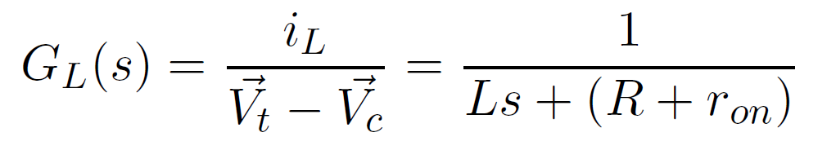
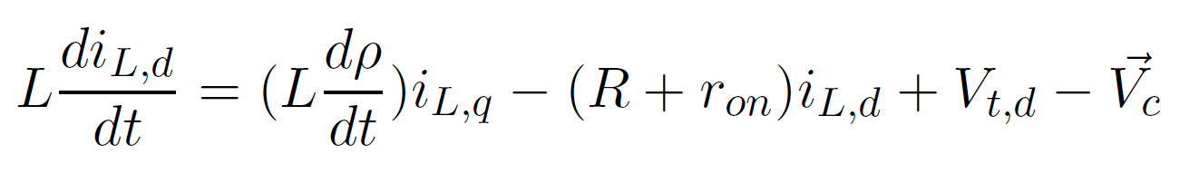
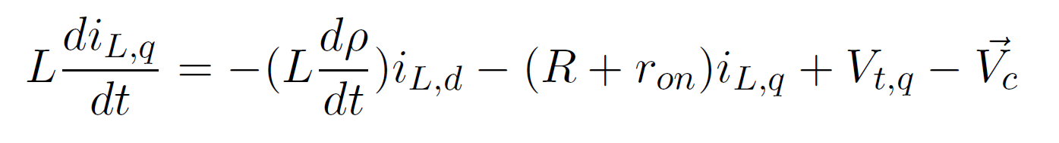
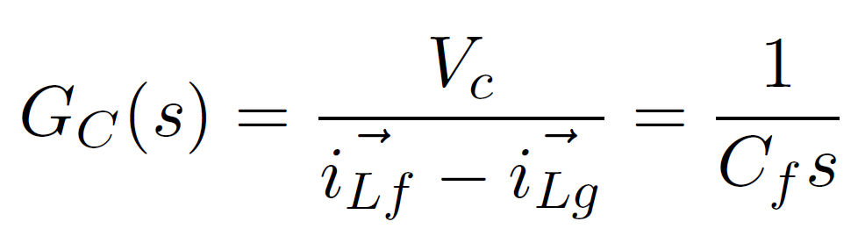
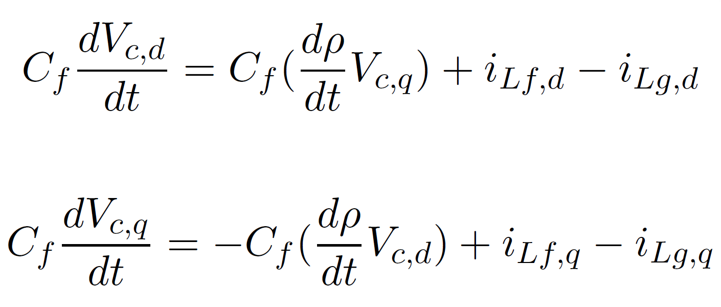
Inverter Plant Equations: LC
Dynamics
2/2
5
Notes:
inductor current dynamics
capacitor voltage dynamics
Plant equations in space vector and in dq form.
Forms the basis for control

Slide 6
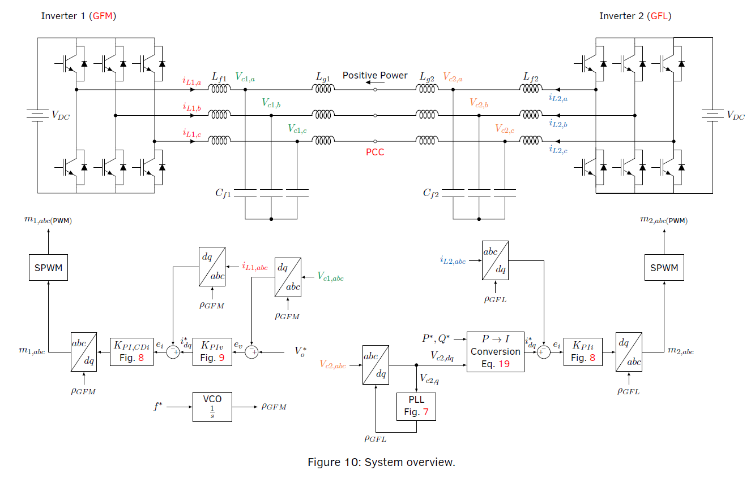
Inverter Control
Control
0/5
GFL PLL, PI Controller
GFL Current Controller (and GFM inner-loop current controller)
GFL Power to Current Reference Conversion
GFL Overview
GFM Voltage Controller
GFM Overview
6
Notes:
DO NOT READ EVERYTHING ON THID SLIDE
GFL features: current controller, PLL
GFM: voltage controller and current controller from GFL

Slide 7
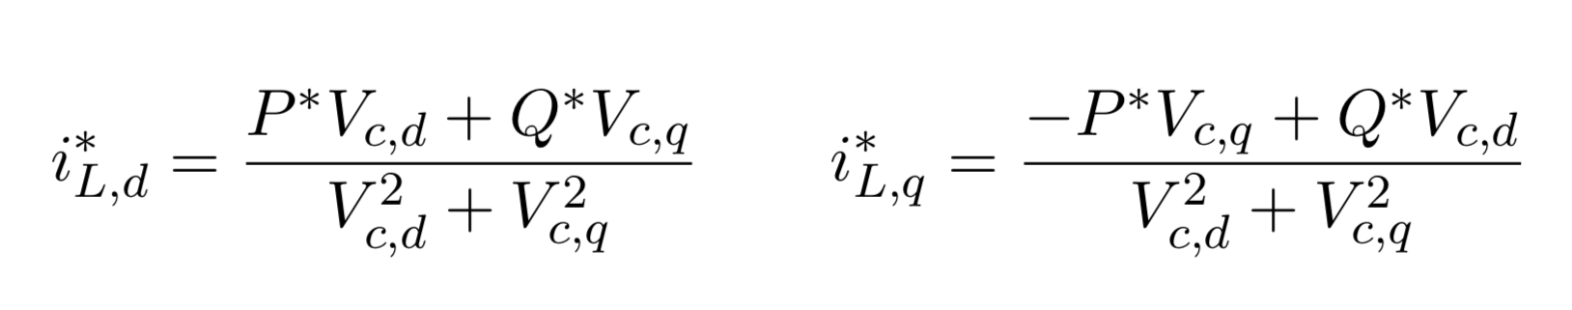
GFL Power to Current Reference Conversion
Control
1/5
7
Notes:
Finally with the power to current reference conversion this completes the GFL control
Because we have a current control strategy – inductor current dynamics plant model

Slide 8
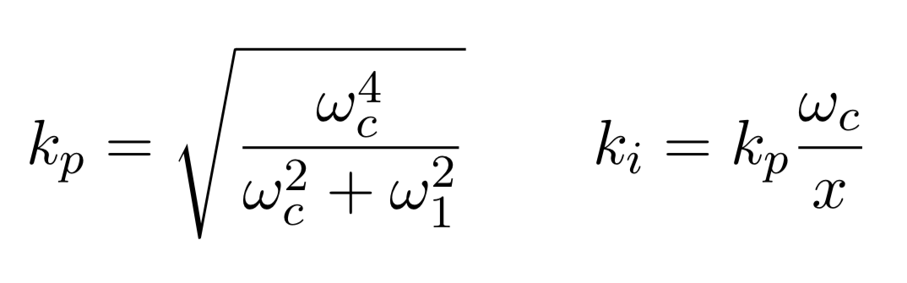
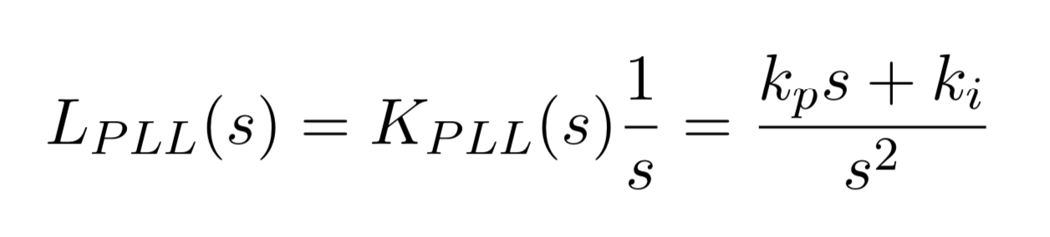
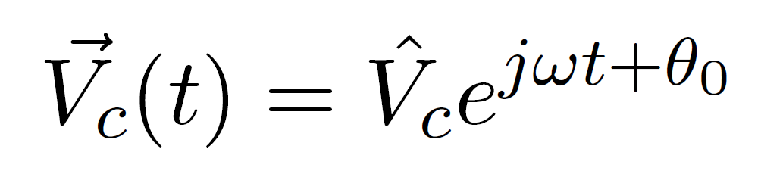
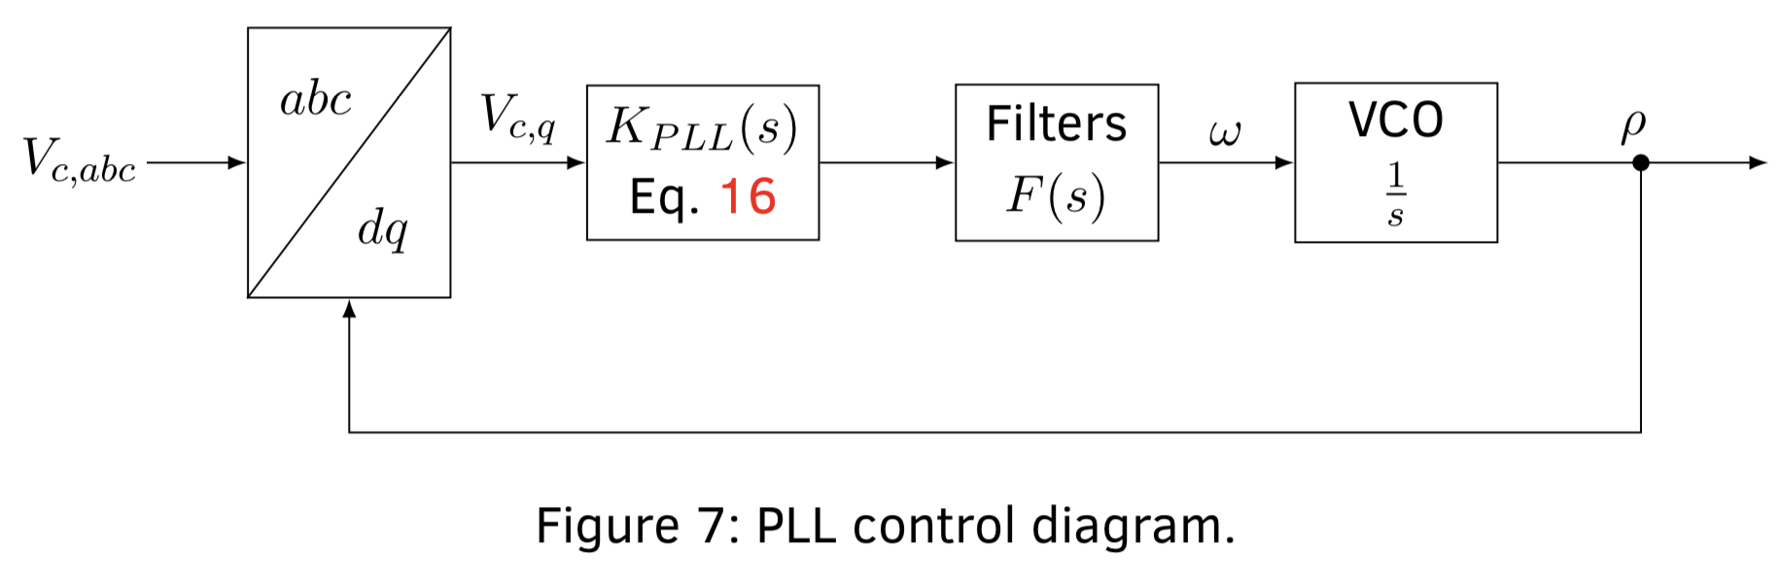
GFL PLL (Phase-Locked Loop)
Control
2/5
Synchronises dq-frame rotation with grid: angular velocity ω and phase ρ
Correct q-component of V_{c} with PI Controller
LPF for attenuation
VCO (voltage-controlled oscillator/ integrator) centred at 50Hz
Phase generated feeds to abc-dq dq-abc blocks
8
Notes:
PI controller chosen based on loop shaping method
Unity loop gain
Separation between cutoff and crossover frequency
LPF: for a stable attenuated response

Slide 9
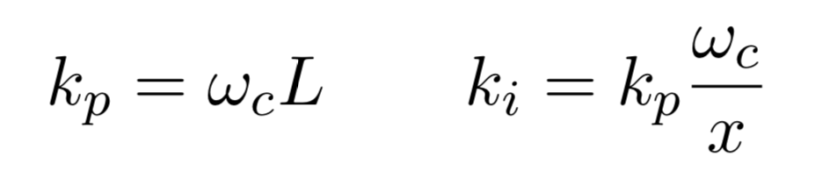
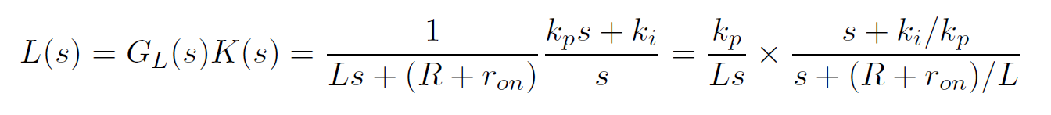
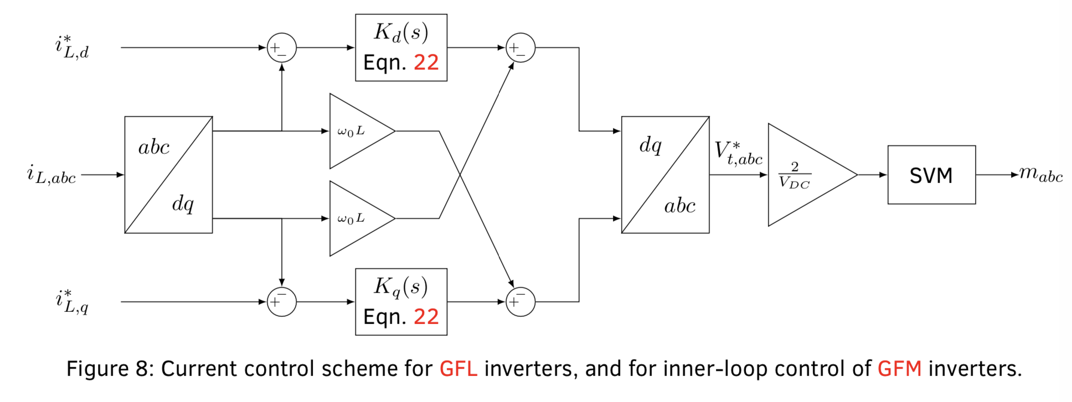
GFL Current Control
Control
3/5
Convert to dq-frame
PI-Controller and cross-decoupling
Convert to abc-frame and modulation
9

Slide 10
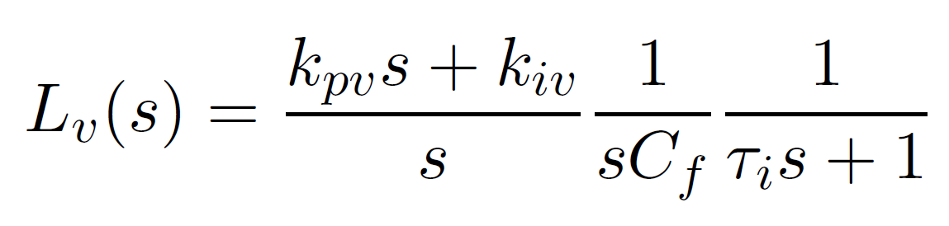
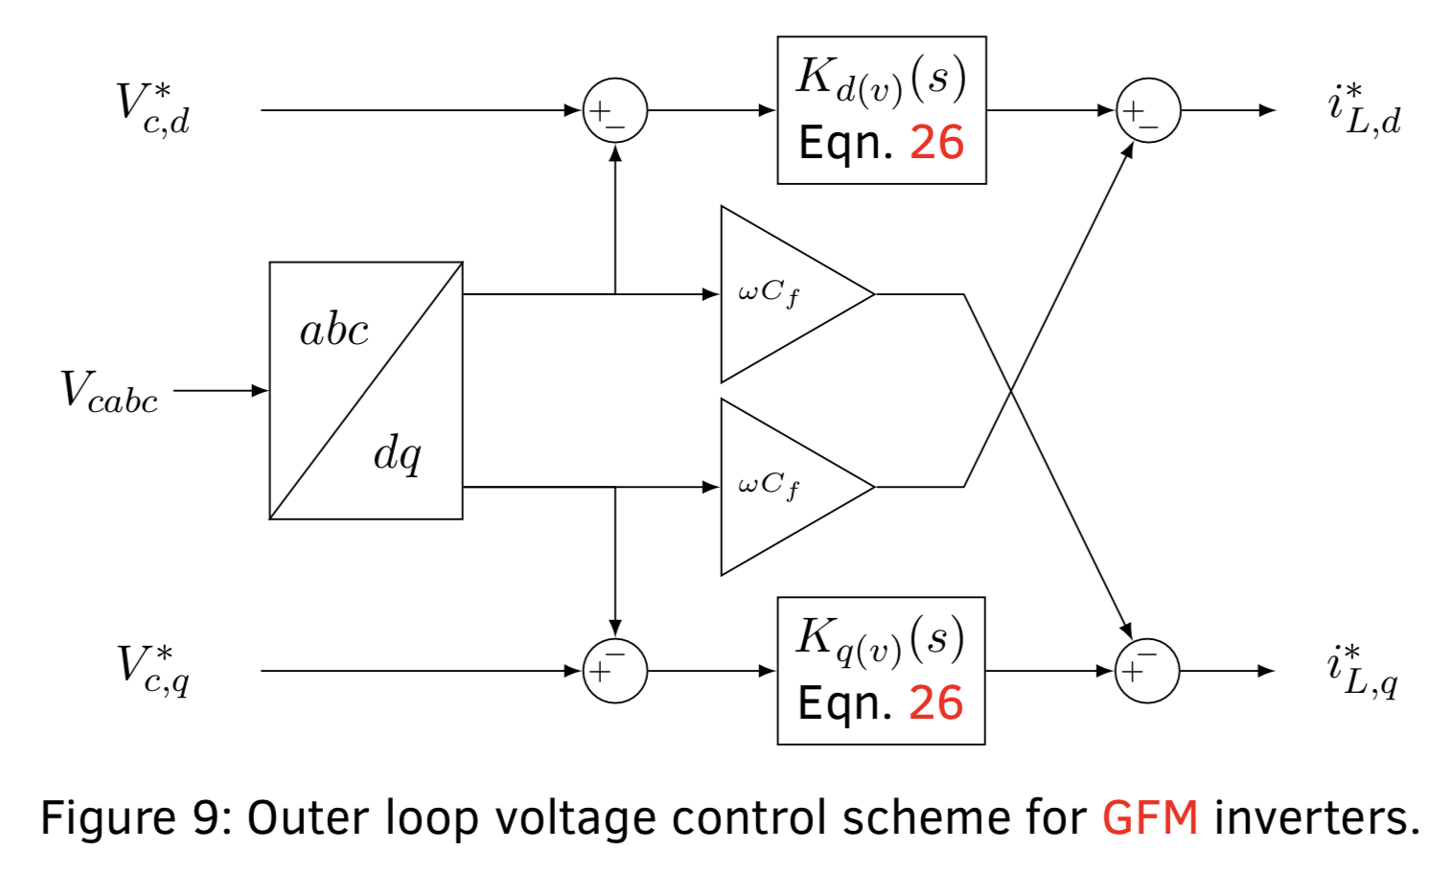
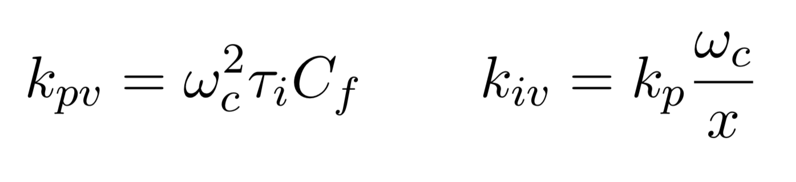
GFM Overview
Control
4/5
10
Notes:
This completes the GFM control setup

Slide 11
11
Notes:
And in combination we can operate a transmission line formed by 2 inverters, control its voltage, and control power flow

Slide 12
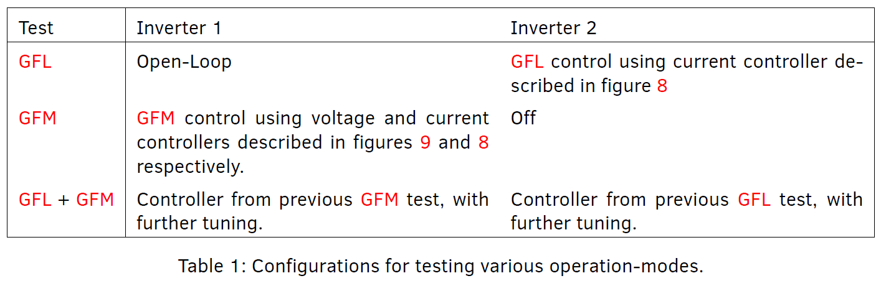
System Overview
Implementation
1/1
12
Notes:
This describes the diagram previously shown: how GFM and GFL can be tested separately and operated together in cosed loop

Slide 13
Tests Overview
Results
0/4
Rationale and results for tests
Open-Loop
GFL
GFM
Dual (GFM and GFL)
13
Notes:
Now I will go through each of the tests listed on this slide
Rationale: why this test is performed
Results: what this has yielded

Slide 14
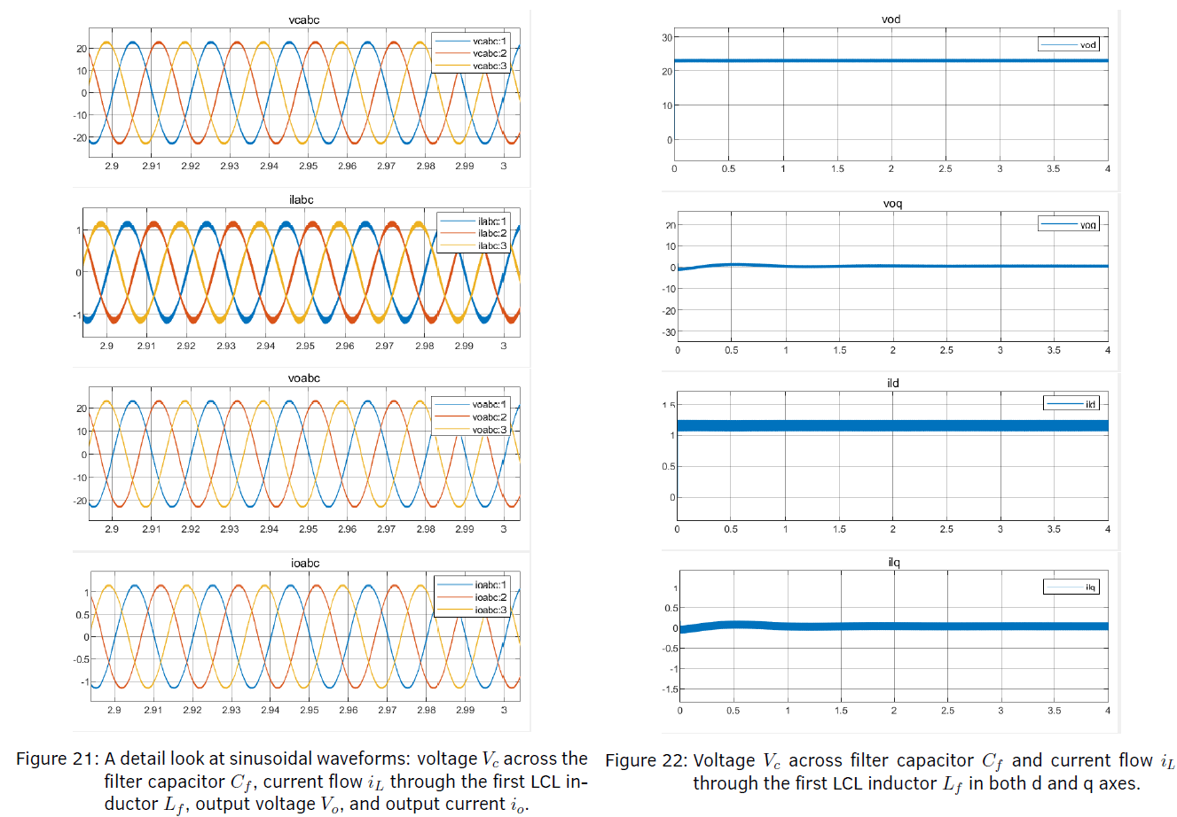
Open-Loop
Results
1/4
Check abc (sinusoidal) waveforms
Calibration, debugging, check ADC protection
PLL: Check stability of dq-results (not tracking)
14
Notes:
Rule of thumb checks
Calibration:
fixing absolute errors,
checking definitions such as power and current definitions (which should be in generator convention), order of phases
Mismatch between zero points will lead to 50Hz oscillations
As expected
All sinusoidal waveforms, filtered version,
50HZ Dominant
PLL: check whether dq results are stable. Correspond to the amplitude (power invariant transform)
Some high frequency oscillations: third harmonic injection (SVM used at the time)
In simulation
Also look at the bode plot (not shown) to check phase margin

Slide 15
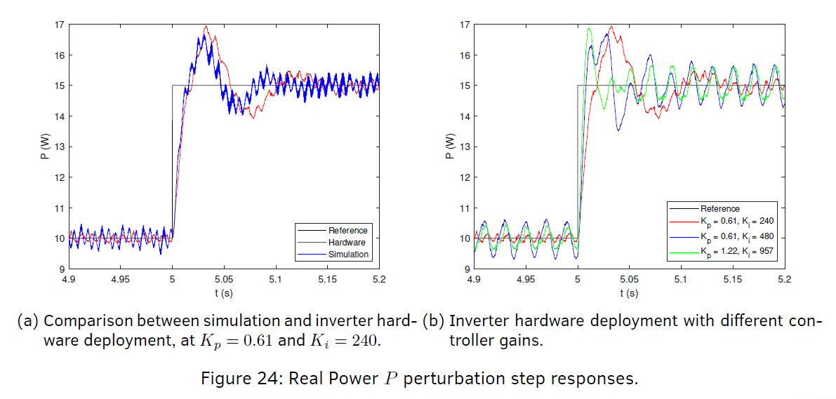
GFL: Power step Change
Results
2/4
Local oscillations: switching, resonance
Low frequency angle swing: controller
Mismatches: ESR of components
15
Notes:
Aim: control real and reactive power exchange. Hence power step change
Inverter 1 Open-Loop, Inverter 2 Closed Loop GFL
Comparison between simulation and hardware to verify validity of the model. Differences
10kHz: switching noise
1kHz: resonance
Mismatch in low frequency angular swing – possibly due to mismatch in ESR leading to different controller compensation.
Comparison between different gains
Larger kp fixe static error and increases slope of rise of first oscillation. But reduces time to accumulate error, leading to increased oscillation magnitudes
Increasing Ki: faster Ki, at the cost of reduced phase margin, leading to more oscillations
Best response is t variable depending on application.
Overall: 0.61,240 (red). best balance in terms of settling time and oscillation magnitude. Good for GFM when stability is required
But 1.22 957 (green) might be a better starting point for GFL – faster response to regulate current controller quicker within the limits

Slide 16
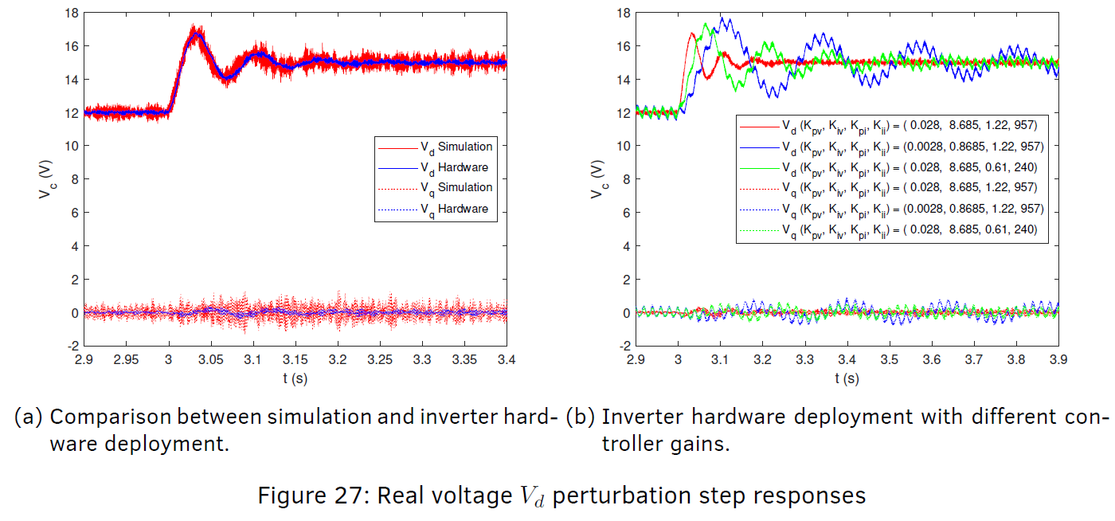
GFM: Voltage step change
Results
3/4
Simulation time-step discretisation – Oscillations beyond sampling rate.
Conflicts between inner and outer loop bandwidth
Marginally stable pole from capacitor voltage dynamics
16
Notes:
GO OVER in 10 SECONDS
Not going through in as much detail (similar rationale)
GFM: control grid voltage and frequency. Here results for Vd step is shown

Slide 17
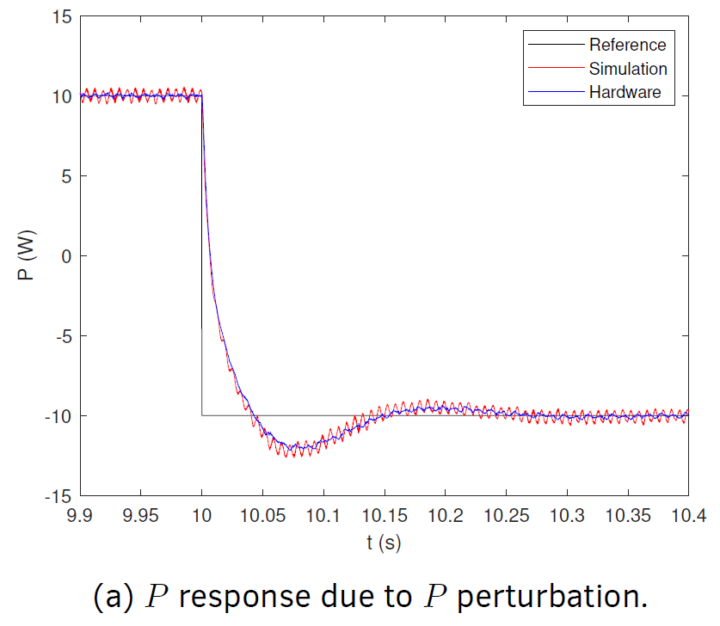
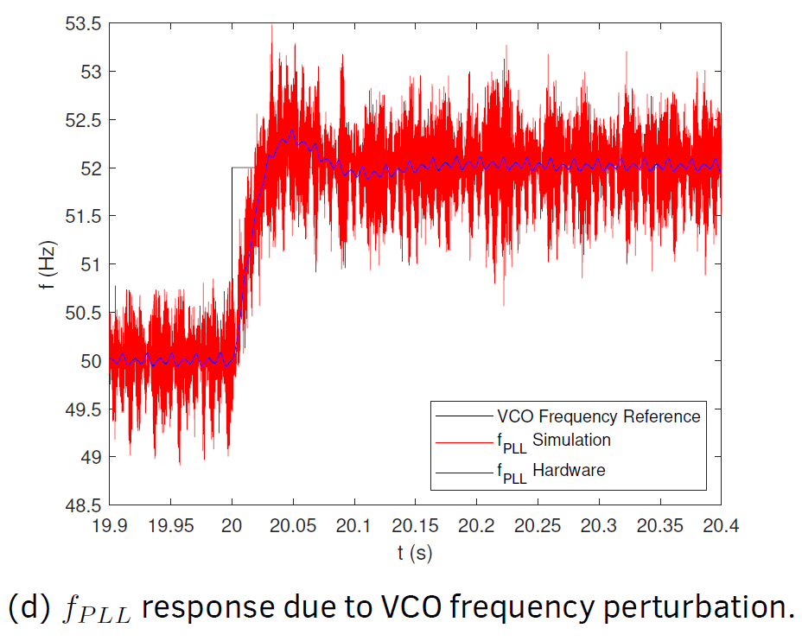
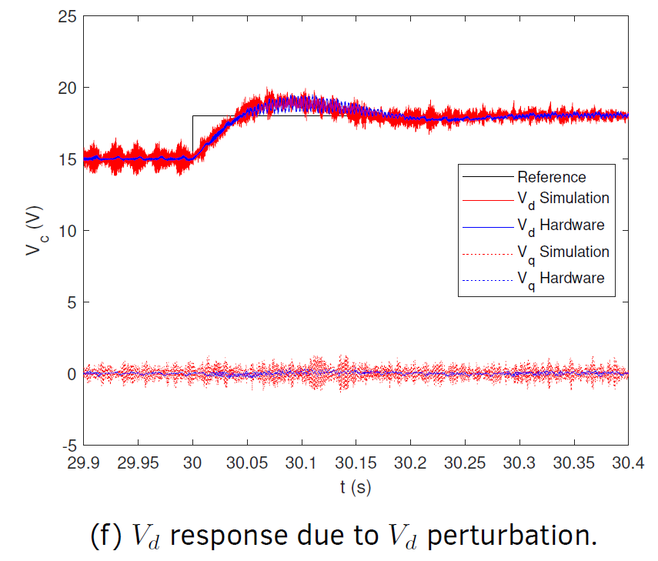
Dual
Results
4/4
Reduce integral gains of inner current loop to increase phase margin and stability (separation between loops)
Increase integral gain of voltage controller for reduced steady state error.
PLL response accelerated
17
Notes:
GO OVER in 10 SECONDS
INCREASE SEPARATION BETWEEN CUTOFF AND CROSSOVER FREQUENCIES
3 tests – combined testing of both in closed-loop
Reduce integral gains of current controller (increase inner loop phase margin and stability). Compensate for the bandwidth separation.
Increasing integral gain of GFM to reduce voltage steady state error and to speed up response
Accelerate PLL by increasing bandwidth and LPF cutoff frequency
Tuning is justified because it is done on real grids as well
with increased penetration of IBRs the synchronous mass is reducing (less stiff)
the dynamics is more reliant on the grid or load impedance
Overall: resilient to grid voltage and frequency perturbations, and can perform both as an importer or exporter.

Slide 18
Conclusion
Conclusion, Evaluation, Future Works
1/1
Dual-Inverter RCP System: deployment from simulation to hardware
Evaluation: Strengths and Limitations
VS Simulations: Reflection of hardware sampling, discretisation and dynamics; but cannot reflect more complex systems
VS High power systems: Safe but low power
Future works
Small signal stability analysis
Board optimisation: higher bandwidth op-amps, DC measurement accuracy, neutral terminal for damping tests
Expansion: testing in parallel
18
Notes:
Proposal of RCP dual-inverter system: verified that the simulation and hardware results largely correspond.
Important: awareness for its limitations – discretisation in simulation, differences in low frequency oscillation due to parasitics mismatch (hard to measure)
Brings us to evaluation
Compared to simulations: less flexibility in terms of cascading more blocks, for example to model solar irradiance effects. Hardware constraints reflected
Compared to high power systems: more flexibility in real time control
Suitable for education and research purposes.
Future works
Small signal stability analysis: so that it can work with a wider range of power perturbations (specifically at lower power) if unstable nodes are identified.
Possible because we can model PI controller as a circuit impedance too
Board optimisation: flexibility for higher slew rate and bandwidth op amp, DC measurement and damping (just to name a few)
More high power tests – DC perturbation – facilitate studies with regards to driving renewable sources which are highly variable

Slide 19
Thank you!
Now for the demo and then questions.
https://www.youtube.com/embed/VnrgIGNwcq8?mute=1;autoplay=1
19
Notes:
<iframe width="560" height="315" src="https://www.youtube.com/embed/VnrgIGNwcq8" title="YouTube video player" frameborder="0" allow="accelerometer; autoplay; clipboard-write; encrypted-media; gyroscope; picture-in-picture; web-share" allowfullscreen></iframe>

Slide 20
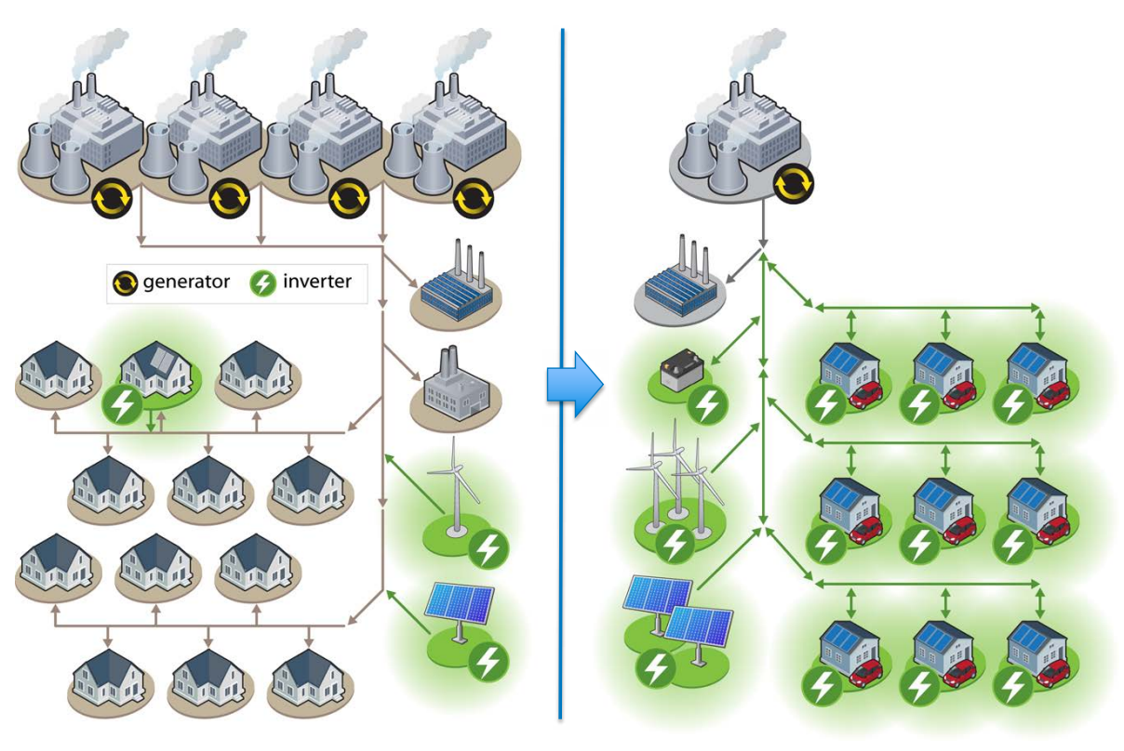
IBR Deployment on Present vs Future Grids
Introduction
Source: “Achieving a 100% Renewable Grid – Operating Electric Power Systems with Extremely High Levels of Variable Renewable Energy,” http://ieeexplore.ieee.org/document/7866938/
Notes:
This brings us to the motivations of the projects
Paris agreement (net zero by 2050) – increasing RES
RES requires IBRs.
Deployment on present AC grids (with synchronous generation)
vs future grids with more renewables. More IBRs and lower inertia
Studying its characteristics/ stability

Slide 21
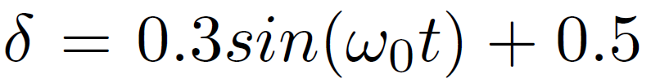
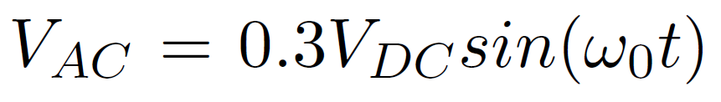

3-Phase DC-AC Half Bridge
Hardware
2/5
SPWM (Sinusoidal PWM) strategy
Dead-time between switches
Offset by 120º to achieve a balanced 3-phase source

Slide 22
Filter
Hardware
3/5
Objectives: Suppress ripples, harmonic distortion and EMI
L vs LC vs LCL
Decrease inductor L_{f} size
Up to 50% reduction in ripple magnitude of high frequency harmonics
Decoupling measurement node from grid impedance
Resonance frequency considerations: 1st vs 2nd vs 3rd order filter
Common Mode Choke

Slide 23
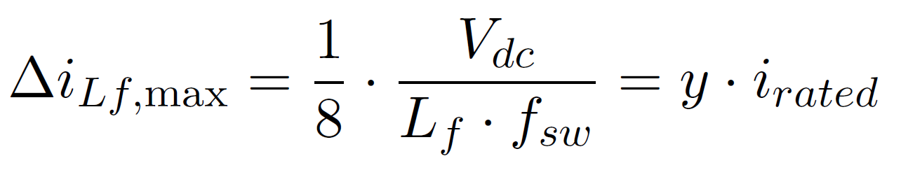
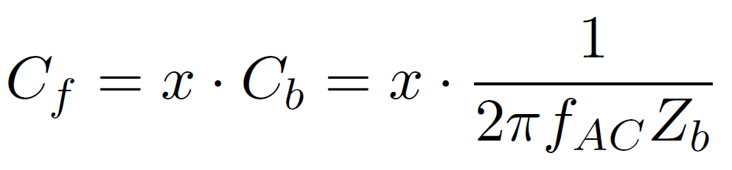
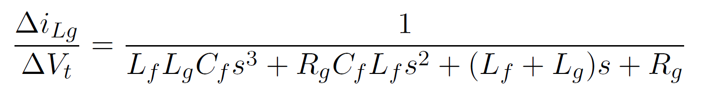
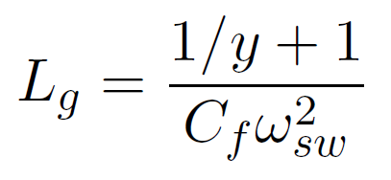
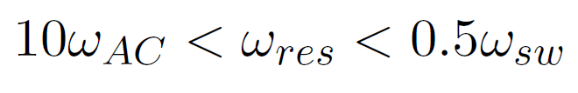
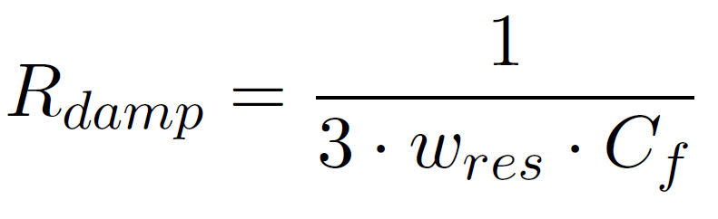
LCL Filter Parameters
Inverter Hardware
4/5
Converter side inductor L_{f} – ripple current magnitude
Capacitor C_{f} – absorb high frequency switching frequency current
Grid-side inductor L_{g} – output current attenuation
Resonance Frequency Verification
Damping Resistor R_{damp} – suppress resonance peak

Slide 24
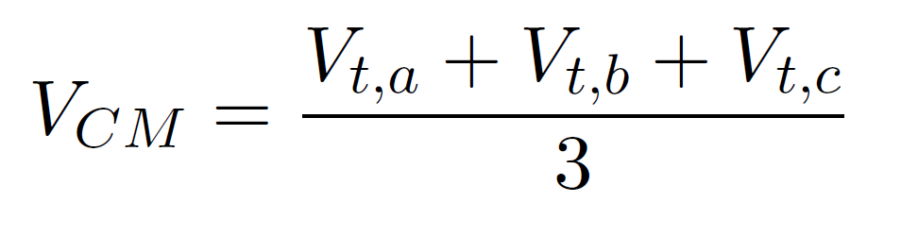
CMC (Common Mode Choke)
Hardware
5/5
Common Mode Voltage
ΔV_{CM} difference between SPWM (sinusoidal PWM) and SVPWM (space-vector PWM) implementation
Rapid changes in ΔV_{CM} leading to high pulsed common mode currents
Attenuation with CMC
Flux created by the common-mode currents accumulate
Produces an impedance that opposes the common-mode currents
Noise returns to source via stray capacitances
Concerns: amount of attenuation, frequency of noise, losses, saturation

Slide 25
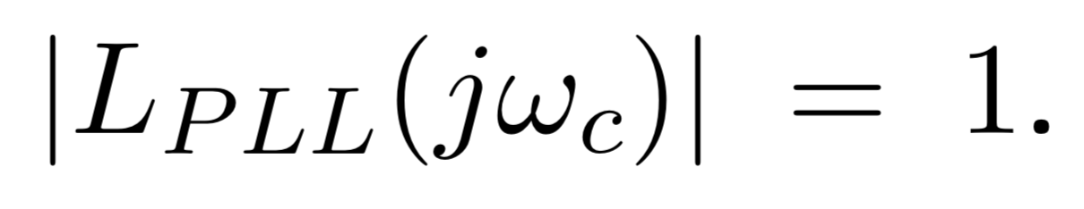
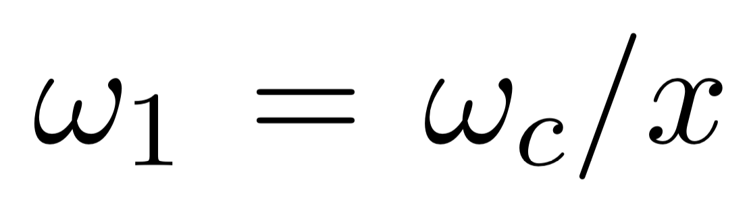
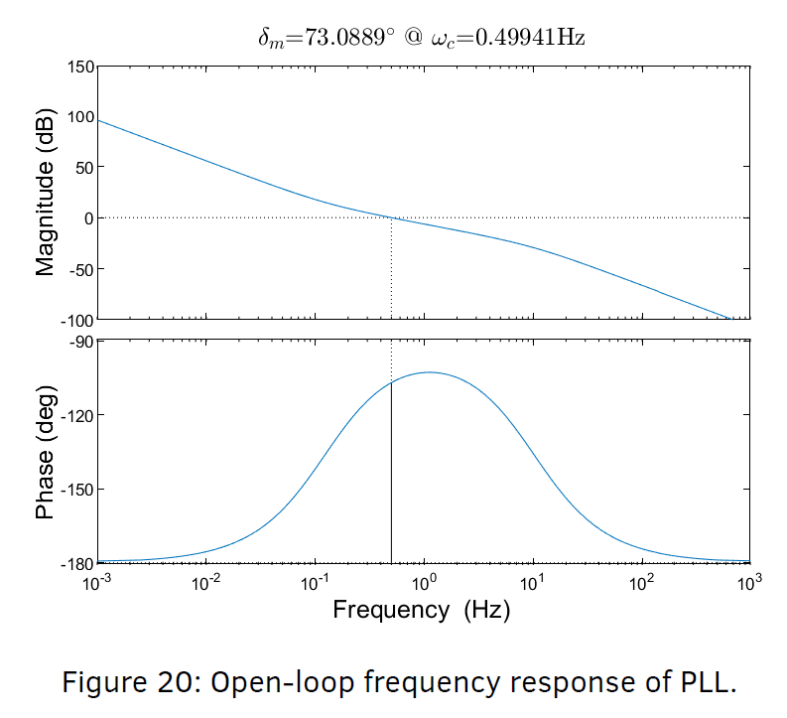
De-tour: PI Controller
Control
2/7
Loop Shaping Method
Unity gain at crossover frequency
Separation between cutoff and crossover frequency

Slide 26
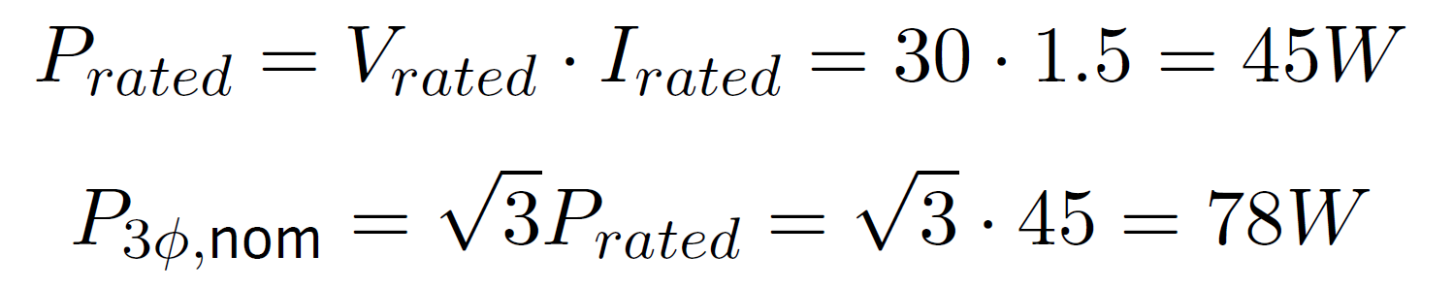
Specifications
Implementation
2/7
DC Bus Voltage V_{DC} 48V: Insulation cabinet not required
Nominal AC Voltage 30V: RMS
Nominal AC frequency 50Hz: Mains frequency
Nominal Phase Current 1.5A: Below 100W
Switching frequency f_{sw} 10kHz: To match IGBT AC-DC Converters
Components
L_{f} = 4 mH
C_{f} = 8.8 μF
L_{g} = 350 μH
Notes:
Skim over in 10 seconds

Slide 27
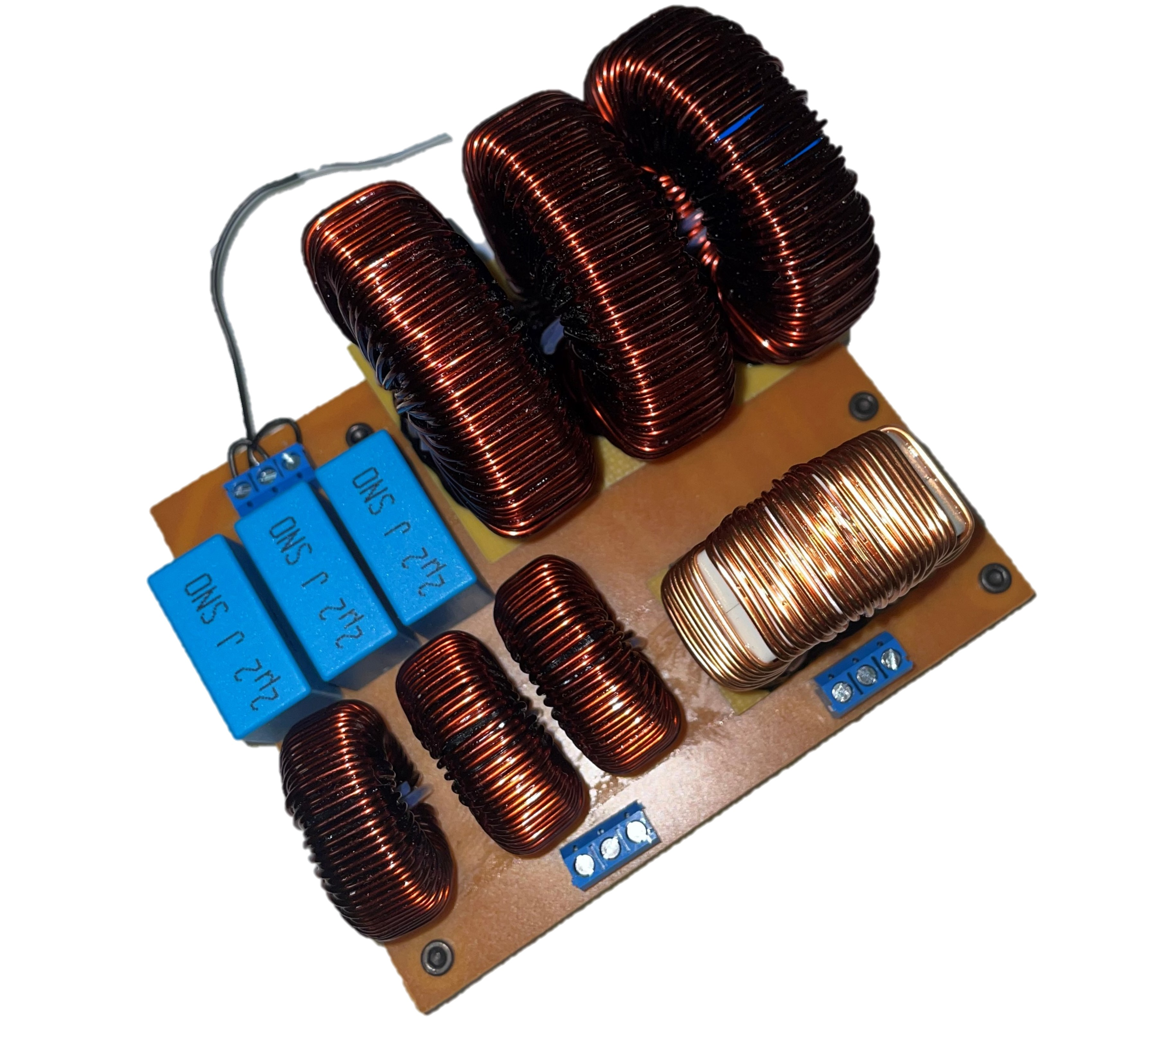
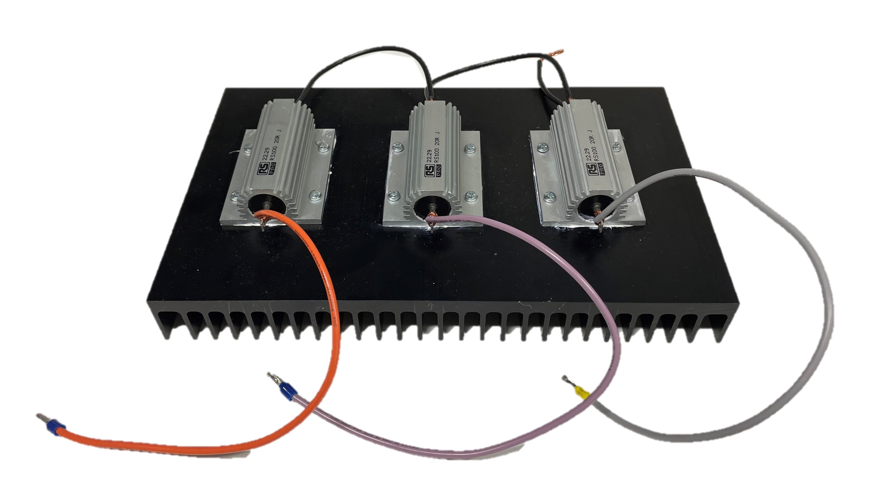
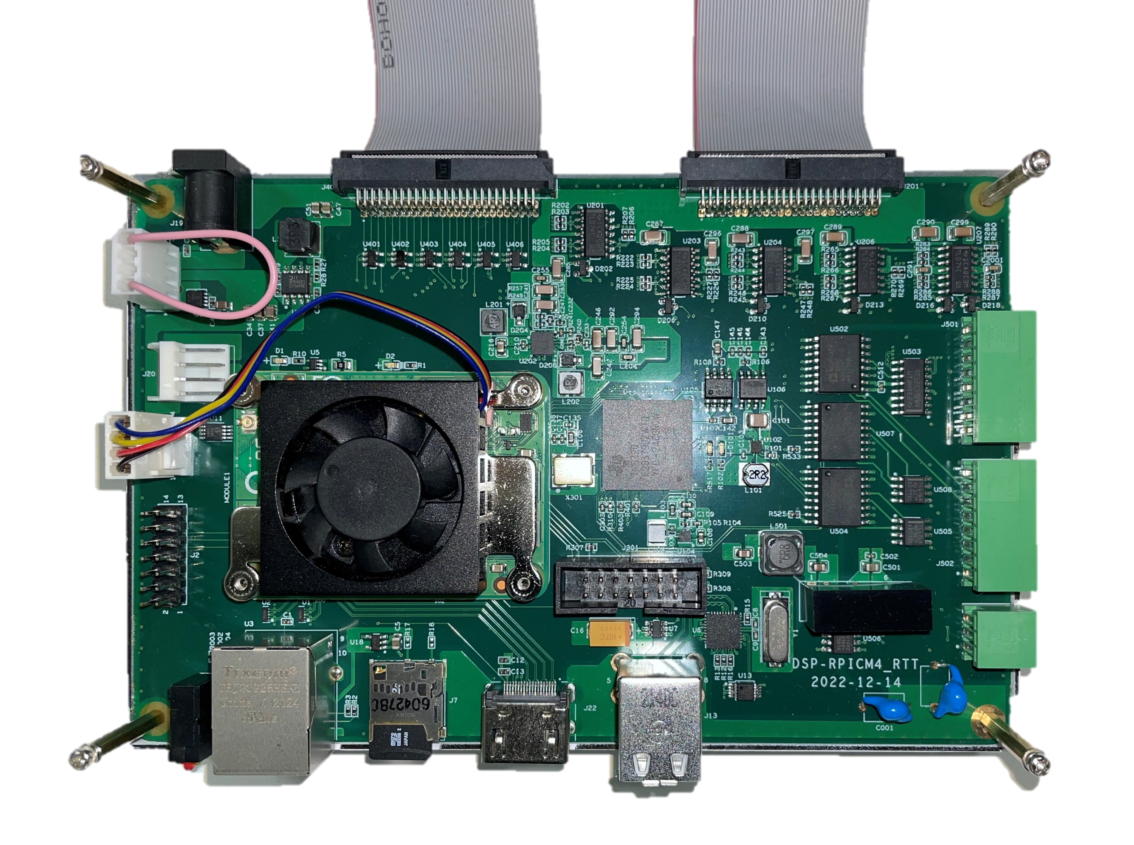
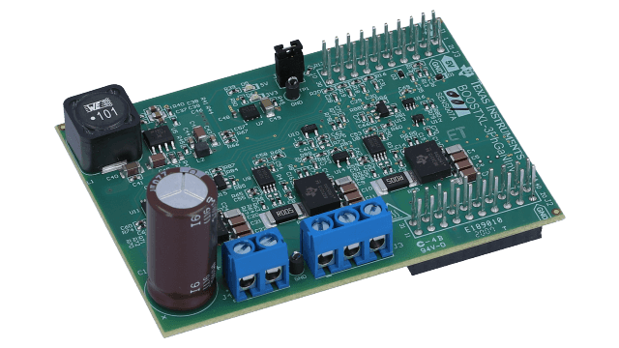
Components
Implementation
3/7
Inverter Filter
Load Resistor
Controller (“Simplus”)
16 channels: EPWM, ADC (voltage, current signals)
RTT (real time target) modification on MATLAB during runtime
3-Phase Inverter Module (“EVM”)
Notes:
Skim over in 30s
Mention Simplus: made by the laboratory, 16 channels
Allows modification of gains and real time gains on MATLAB during runtime

Slide 28
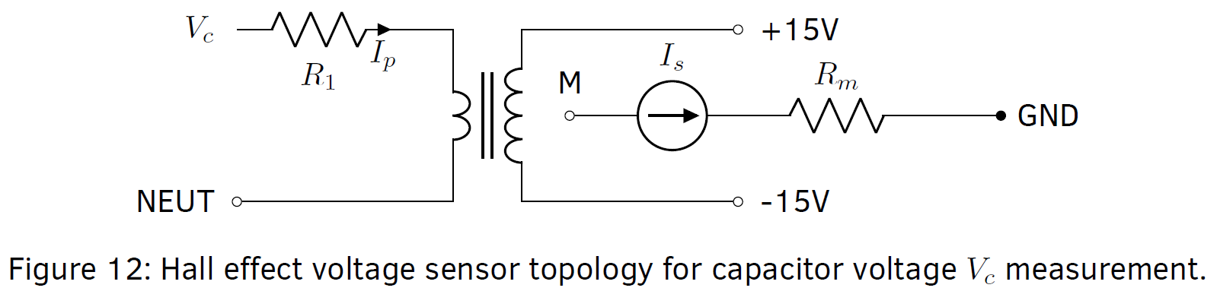
Auxiliary Circuits: V_{c} Hall Voltage Measurement
Implementation
4/7
Hall Effect Voltage Transducer LV 25-P Resistance Parameters
Limit primary coil current (depends on maximum primary voltage)
Scale secondary voltage with resistor

Slide 29
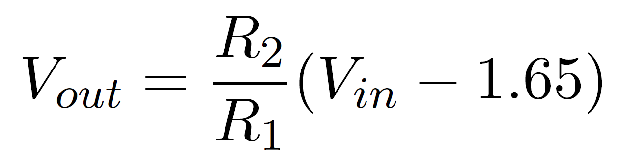
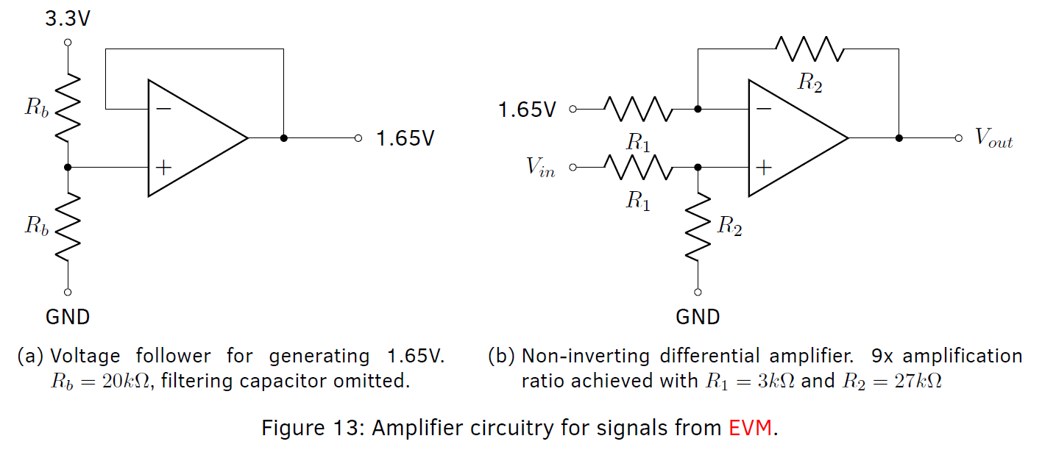
Auxiliary Circuits: Amplify EVM Measurements
Implementation
5/7
Amplify 0-3.3V signals to ±15V to take full advantage of ± 2048 (digital)

Slide 30

Circuit Layout
Implementation
6/7
Notes:
Circuit layout: also consisting of measurement circuitry

Slide 31


Circuit: Overview for Signals
Implementation
7/7

